Slide 1
Enzymes I
Dr. Wasanthi Subasinghe

Slide 2
Objectives
At the end of this lecture you should be able to,
Define enzyme [En]
Explain the general properties of En
List 6 classes of En
Illustrate the mechanism of En activity and specificity
Explain the factors affecting the En
Define the term K_{M} and V_{max} and indicate their biochemical significances

Slide 3
What are enzymes?
protein catalysts that increase the rate of reactions without themselves being changed in the overall process.
Almost all enzymes are proteins
Exception
RNA catalysts (ribozymes) antibody catalysts (abzymes)
Notes:
Rate No T change

Slide 4
Naming enzymes
Recommended Name
Substrate + End in suffix “ase”
Sucrase – react on sucrose
Lipase - reacts on lipid
Function + End in suffix “ase”
Oxidase – catalyzes oxidation
Hydrolase – catalyzes hydrolysis
Exception :pepsin, trypsin

Slide 5
classification of enzymes
Class | Type of reaction catalyzed
Oxidoreductases | catalyze a redox reaction
Transferases | transfer a functional group with C, N or P
Hydrolases | catalyze hydrolysis rxns
Lyases | Addition or removal of C-C, C-S and C-N bonds
Isomerases | rearrange to form isomers
Ligases | Formation of C-C, C-N, C-O or C-S bonds coupled to ATP cleavage

Slide 6
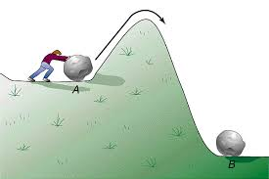
How does En increase rate of a reaction?

Slide 7
How does En increase rate of a reaction?

Slide 8
Enzyme structure

Slide 9

The active site
Active site: a small region of the enzyme molecule at which the substrate binds and participate in catalysis
Shape and the chemical environment inside the active site permits a chemical reaction to proceed more easily

Slide 10
Enzyme Specificity
interact with one or a few specific substrates and catalyze only one type of chemical reaction
1. Substrate specificity
Act only on one substrate (Absolute specificity) or on few structurally similar substrate (Relative specificity)
2. Steriospecificity
Act only on one isomers
3. Reaction specificity
They catalyze only one type of reaction

Slide 11
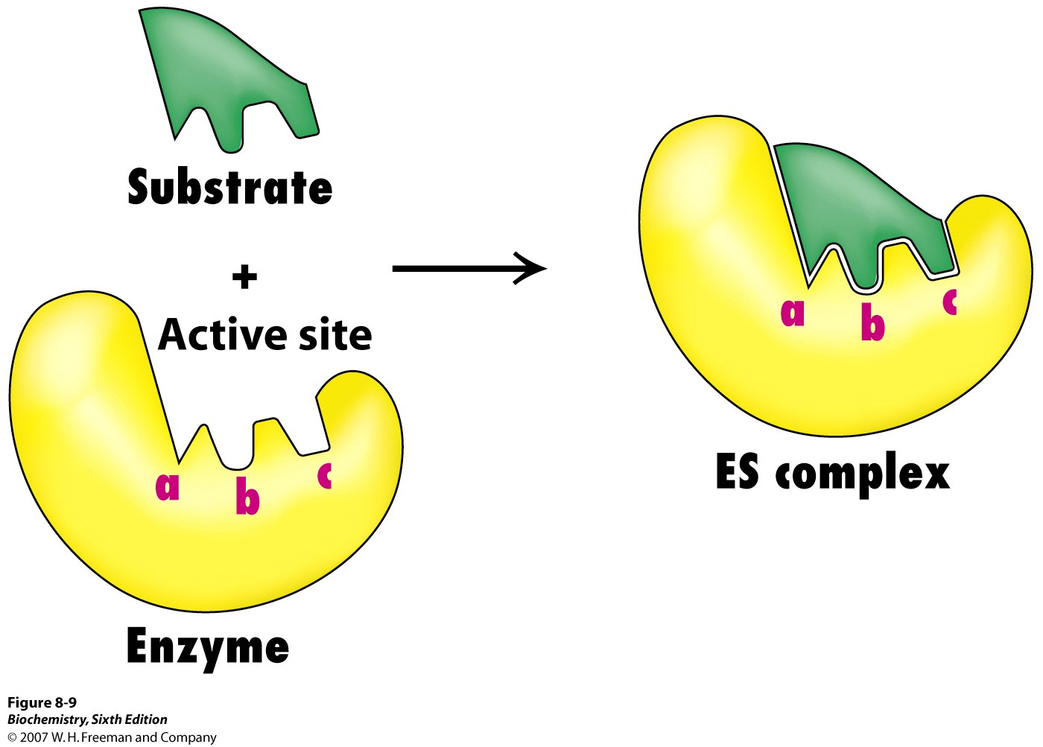
Mechanism of Enzyme Action
“Lock and Key” concept by Emil Fischer
k₁
k₂
E + S ES E + P
k₋₁
Substrate binds at the active site of the En
Forms En-substrate complex
Substrate reacts to form product
Product is released

Slide 12
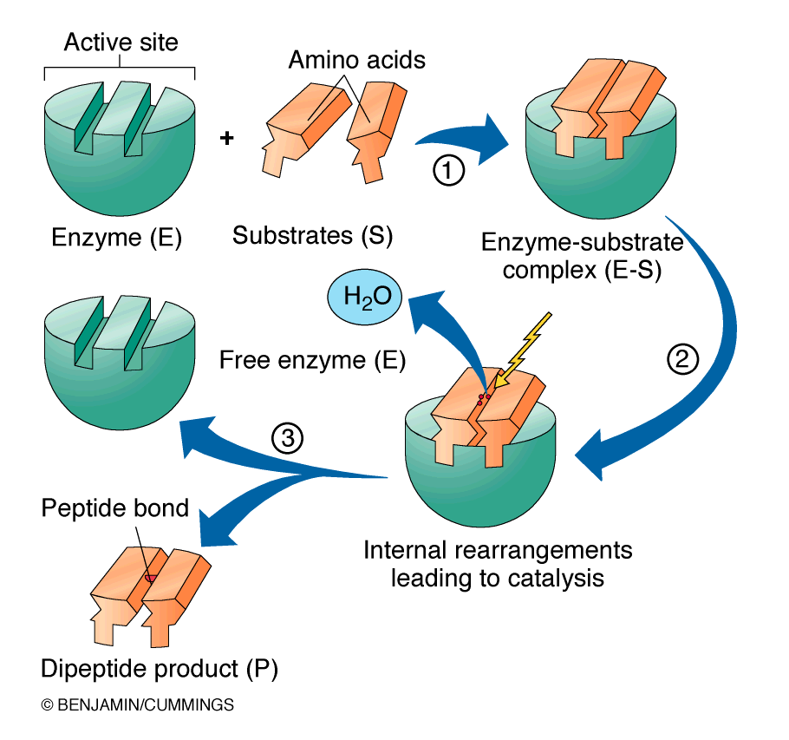

Slide 13
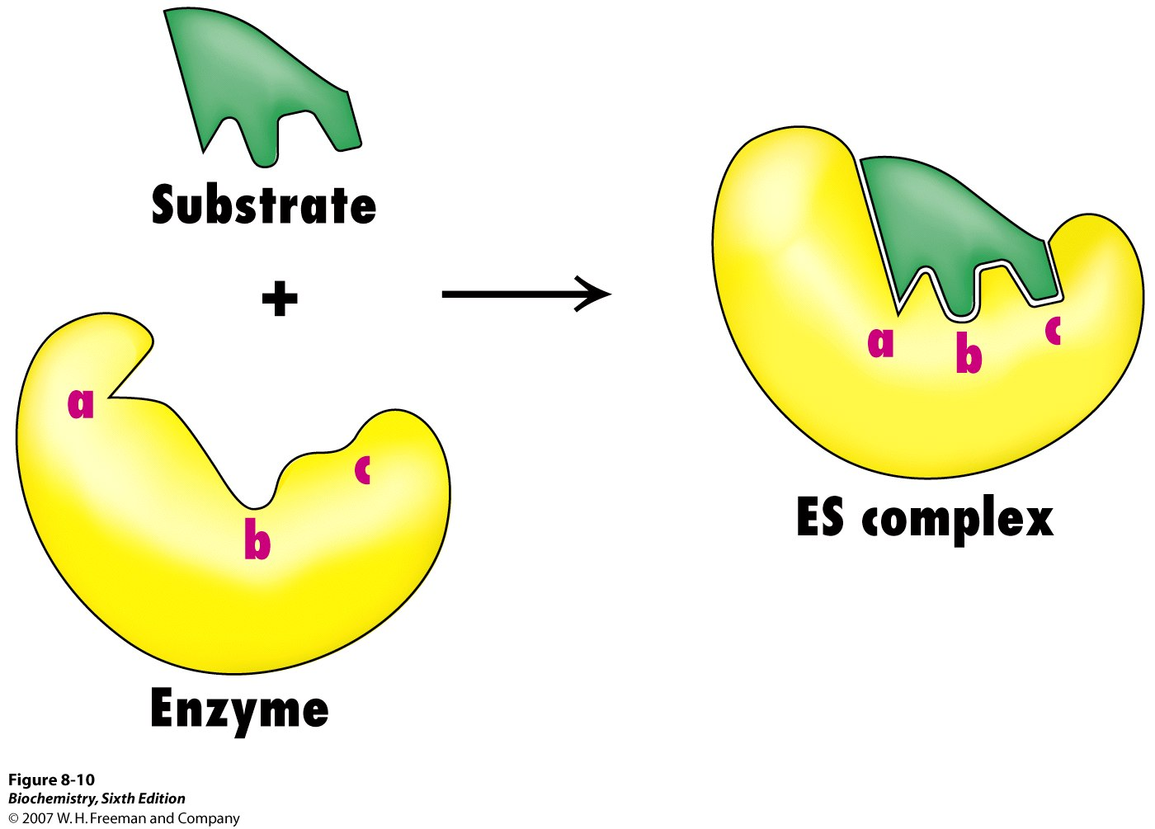
Induced Fit – Koshland (1963)

Slide 14
Factors affecting Reaction rate
Substrate concentration
Enzyme concentration
Temperature
pH
Type of electrolyte and their concentration

Slide 15
1. Effect of enzyme concentration
Velocity of the reaction increases with the increase of the enzyme concentration
Reaction velocity
Enzyme concentration

Slide 16
2. Effect of Temperature
Rate increases until a peak velocity is reached at optimum T
Further elevation of the T decrease in velocity : T induced denaturation of the enzyme.
Most enzymes are fully denatured at 70°C

Slide 17
3. The effect of pH
Optimum pH values
Enzyme activity
Trypsin
Pepsin
1
3
5
7
9
11
pH

Slide 18
Effect of pH
Effect of pH on ionization of active site
- alter the charge distribution along the entire enzyme thus change the conformation of it.
- So active site would be alter.
- Ever enzyme has an optimum pH in which the reaction velocity is optimum.
Effect of pH on denaturation of enzyme
- extreme pH can lead to denature of the enzyme

Slide 19
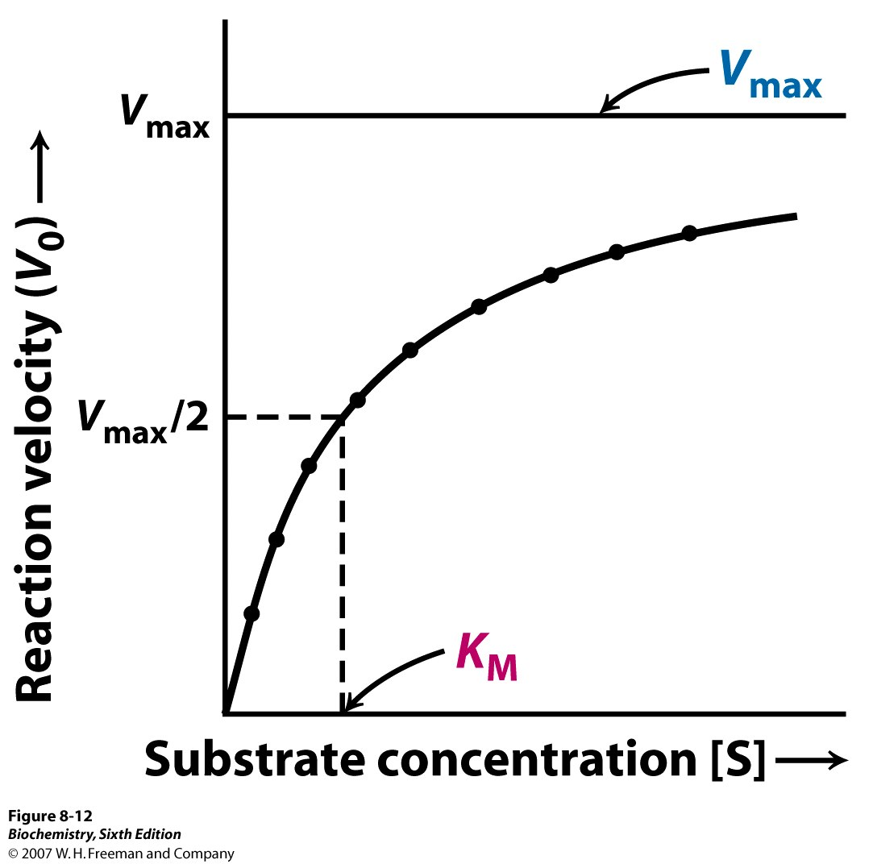
4. Effect of substrate concentration
Michaelis-Menton Plot: hyperbolic shape

Slide 20
Michaelis-Menton kinetics
maximal velocity [V_{max}] : Rate reaction increases with substrate until a V_{max} is reached due to saturation of active site
V_{max} depends on
1. Time required for product to be released 2. How many enzyme molecules are present

Slide 21
K_{M} (Michaelis Constant):Substrate concentration at which the initial velocity is half the maximal velocity
V_{max}[S] v_{o} = ----------- K_{M} + [S]

Slide 22
Effect of substrate concentration
@ High [S]
V independent of [S]
zero order reaction
@ Low [S]
V ∞ [S]
1st order reaction

Slide 23
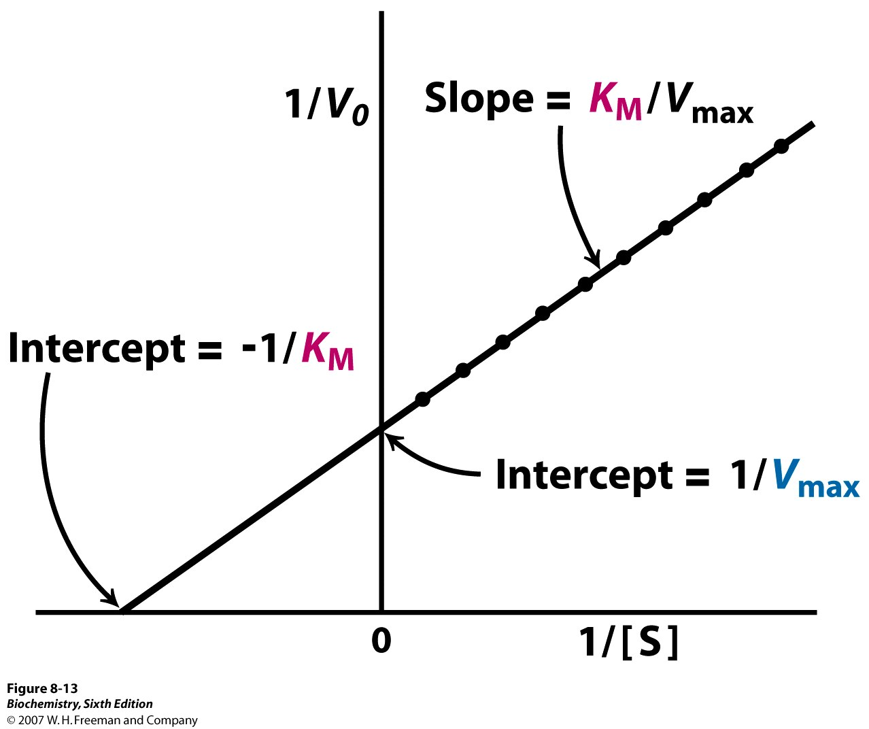
Determining K_{M} and V_{max}
Lineweaver-Burke Plot : double reciprocal plot

Slide 24
Biochemical Significance of K_{M}
K_{M} varies with pH, temperature and structure of substrate but independent from enzyme concentration
2. Reflect the affinity of enzyme for a substrate
↑K_{M} ↓substrate affinity
↓K_{M} ↑substrate affinity
3. An enzyme react on two different substrate has two K_{M} values. But the enzyme would prefer the substrate with low K_{M} value
e.g. Hexokinase
Glucose → Glucose -6-P 1x10⁻⁵ M
Mannose → Mannose -6-P 1x10⁻³ M
4. If two enzymes catalyze the same reaction then the enzyme with the low K_{M} value would be more efficient than the other

